Slide 1
Nerdblock – Logical Solution
Ahmed Naveed, Alexzander Saddler, Graeme Jeffreys, Muhammad Yasir Patel, Valentine Sah

Slide 2
Logical Requirements - Database

Slide 3

Database: Scalability & Performance
Scalability and performance
High volume handling
Elastic Scalability
Efficient design
Redundancy reduction

Slide 4
Logical Requirements – Front End

Slide 5
Front End – Customer & Admin
Intuitive design
Easy to use
Multi-platform Access
Order tracking system
Customer view
Admin dashboard:
Inventory
Fully integrated Report system

Slide 6
Logical Requirements – Back End

Slide 7
Back end – Database & System Integration
*****PLEASE FILL IN INFO**********

Slide 8
Database Highlight: 3NF & Data Dictionary & ERD

Slide 9

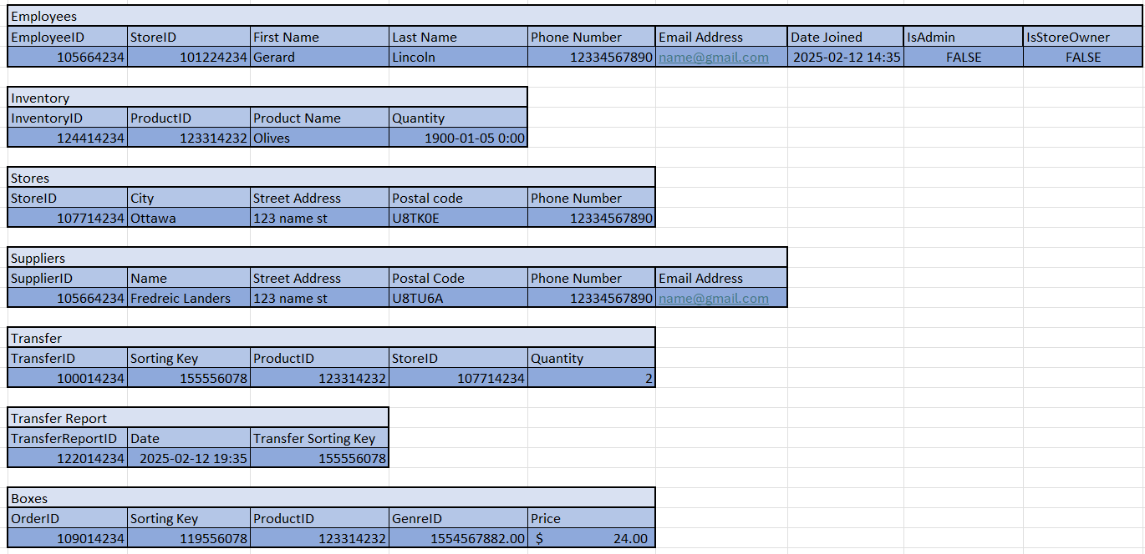

Slide 10
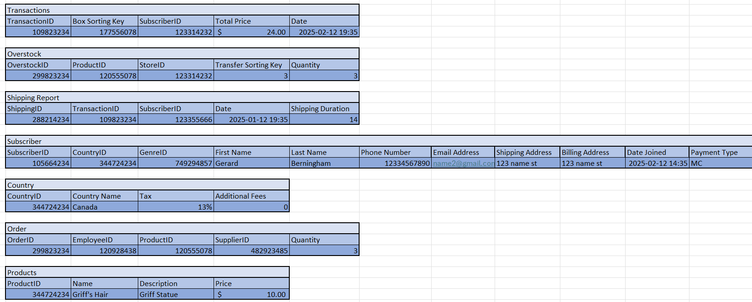
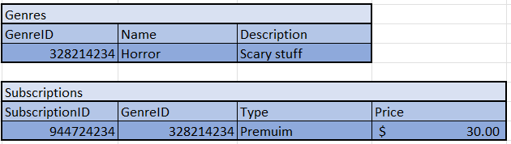

Slide 11
Data Dictionary & ERD
Refer to Data Dictionary Excel Sheet Link:
https://docs.google.com/spreadsheets/d/1D7_W4t1T3c-ePl9hXWh-EY2vUjCJ58qP/edit?gid=1686943866#gid=1686943866
Refer to ERD for further explination.

Slide 12
Database Demo
Please Refer to the SQL code:
Table Creation
Queries
Insert Statements

Slide 13
Web Application Demo
Please Refer to the web application.

Slide 14
Trello – Project Management Demo
Please refer to Trello board highlighting the Project Management process.

Slide 15
Conclusion
Our integrated application and database promote scalability, and continuity, providing a future-proofed solution
Thank you

